Slide 1


MORTALITY PREDICTION IN COVID-19 CASES
EPICS Phase 2 - Progress Review II
Group No - 290
SUPERVISED BY
Dr. Amit Singh
PRESENTED TO
Dr. Ravi Verma
Dr. Mohammad Sultan Alam

Slide 2


Content
1
Introduction
5
Background
2
Objective
6
Data collection
3
Methodology
7
Evaluation
4
Result
8
Conclusion

Slide 3
Meghavi Jadhav
Shrey Patel
Shefali Jain
Vinamra Rawat
Team Members
Swati
Dhruv Sharma
Harshitaa Ashish
Mihir Chaudhary
Aditya Pandey

Slide 4

INTRODUCTION
In the face of the unprecedented challenges posed by the global pandemic, understanding mortality trends has become paramount for healthcare professionals, policymakers, and communities worldwide. Our project endeavors to harness the power of data analytics to predict mortality rates, providing invaluable insights to guide strategic responses.
In the following slides, we will delve into the methodology, data sources, predictive modeling techniques, expected outcomes, and implications of our analysis.

Slide 5

BACKGROUND
The COVID-19 pandemic, emerging in late 2019, prompted an urgent need for predictive models to forecast its spread and inform response strategies. With its dynamic nature and impact on healthcare systems worldwide, accurate predictions are essential for optimizing resource allocation and guiding public health interventions.

Slide 6
OBJECTIVE
Develop Predictive Models: Leveraging machine learning algorithms and statistical techniques, we seek to develop robust predictive models
Analyze COVID-19 Data: We aim to comprehensively analyze COVID-19 datasets to uncover patterns, correlations, and factors influencing mortality rates. By conducting thorough exploratory data analysis (EDA), we strive to gain insights into the complex dynamics of the pandemic.

Slide 7

METHODOLOGY
DATA COLLECTION
Sources of Data: Public health databases, government reports, research papers
Types of Data: Demographics, casualties , hospitalizations, interventions, etc.
Data Preprocessing: Cleaning, normalization, feature engineering using onehotencoder library
Model Training and Validation
Splitting data into training, validation, and test sets
Training the chosen models with selected features
Evaluating model performance using validation set

Slide 8
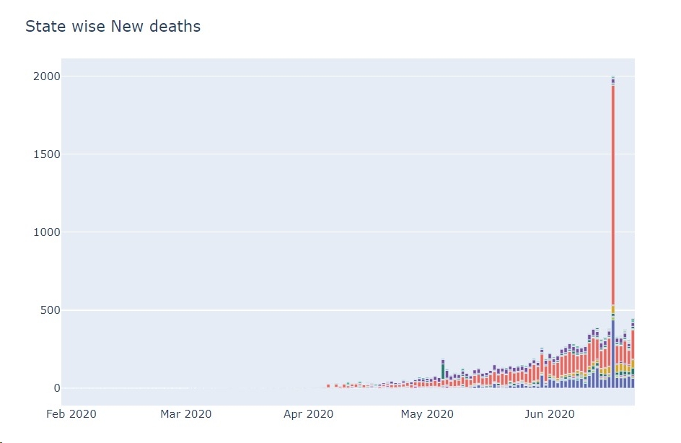
METHODOLOGY
MODEL SELECTION
Overview of models: Logistic Regression, k-nearest neighbour, Random Forest, SVM, gradient boosting, , etc.
Model Selection: Cross-validation, hyperparameter tuning
Evaluation Metrics: Accuracy, precision, recall, F1-score, ROC-AUC

Slide 9

WORKFLOW
DATA PREPROCESSING
DATA COLLECTION
FEATURE ENGINEERING
MODEL DEVELOPMENT
MODEL EVALUATION
MODEL INTEPRETATION
MODEL DEPLOYMENT

Slide 10
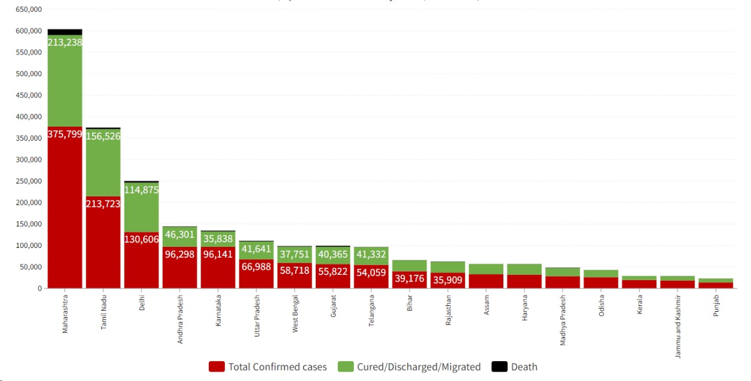
VISUALIZATION OF AFFECTED STATE WISE

Slide 11
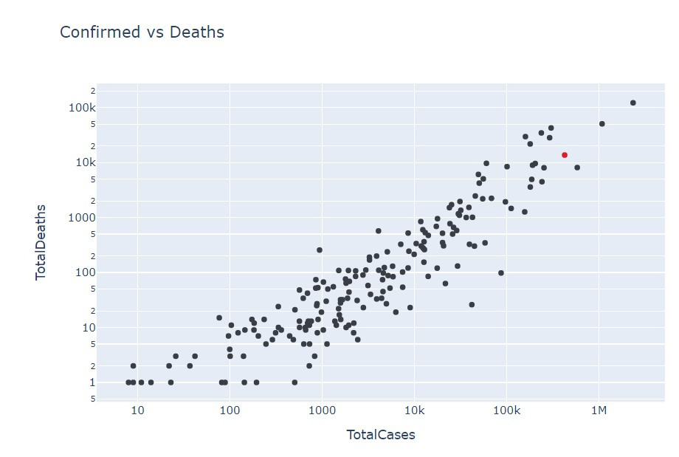
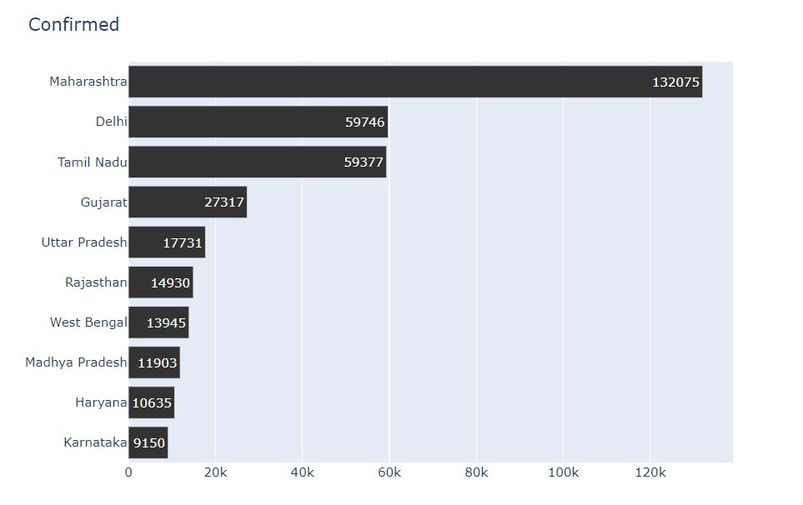
RESULTS CHARTS

Slide 12
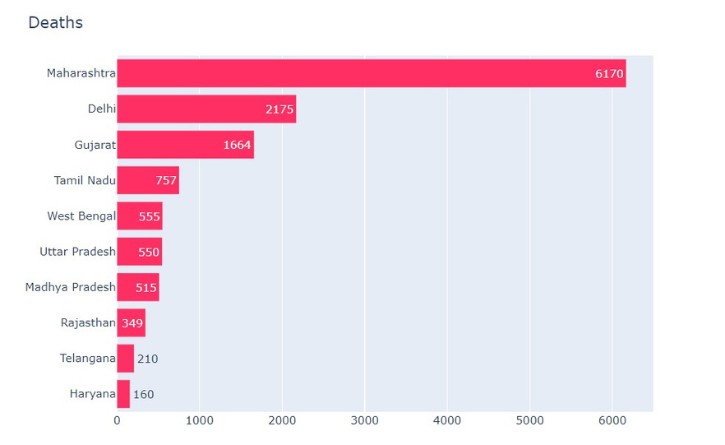
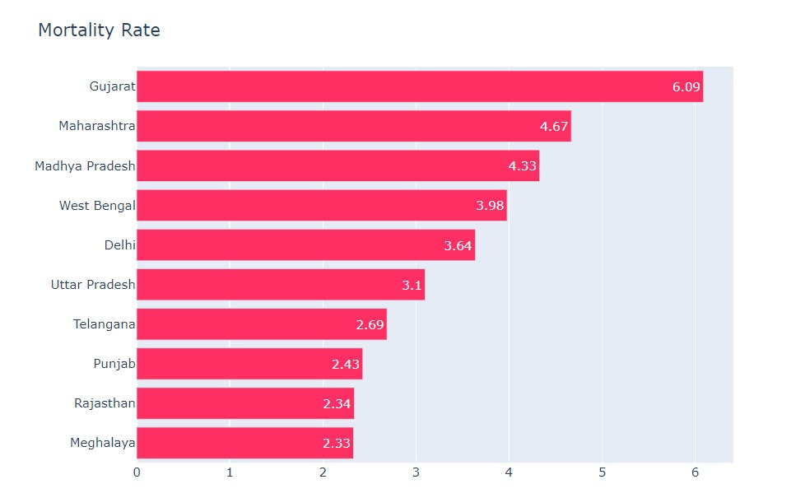
INSIGHTS INTO KEY PREDICTORS OF MORTALITY RATE

Slide 13
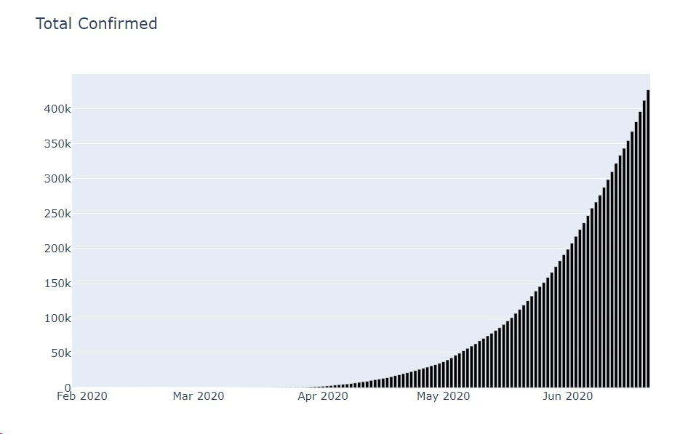
DATA COLLECTION
The dataset used is provided by the Indian Govt. which contains a total of 18,000 patients’ information, including their states, their nationality , number of cured patients, no. of patients died and Number of confirmed cases

Slide 14
FUTURE DIRECTIONS
To perform continuous model refinement with updated data
Extension to other infectious diseases or healthcare domains to broaden the areas for providing decision support
Collaborations with healthcare professionals and policymakers for optimum and reliable services

Slide 15
CHALLENGES & LIMITATIONS
Data quality and availability constraints
Generalizability of models across different populations
Ethical considerations in healthcare data access
Creating relations between different datasets

Slide 16
RESULT
APPLICATION IN HEALTHCARE
PERFORMANCE METRICS OF TRAINED MODELS
Comparative analysis of different algorithms
Insights into key predictors of mortality rate
Integrating the predictive model into healthcare systems
Real-time monitoring of mortality risk for COVID-19 patients
Supporting clinical decision-making and resource allocation.

Slide 17

CONCLUSION
Our project on COVID-19 mortality prediction has provided valuable insights for public health response.
Accurate predictive models and data-driven recommendations aid in early intervention and resource allocation.
We remain committed to refining our methods and contributing to the global effort in combating the pandemic.
Together, let's leverage data analytics to save lives and build a healthier future.

Slide 18
Thank you

